Slide 1
DATABASE
Introduction to Databases

Slide 2
Database Systems
A database is an integrated collection of logically related records or files consolidated into a common pool that provides data for one or more multiple uses.

Slide 3
Why use DataBases?
Databases make it easy to store large quantities of information. The larger the mass of information, the bigger the benefit of using a database.
Databases make it easy to retrieve information quickly and flexibly.
Databases make it easy to organize and reorganize information. You can quickly switch between schemes.
Databases make it easy to print and distribute information in a variety of ways.

Slide 4
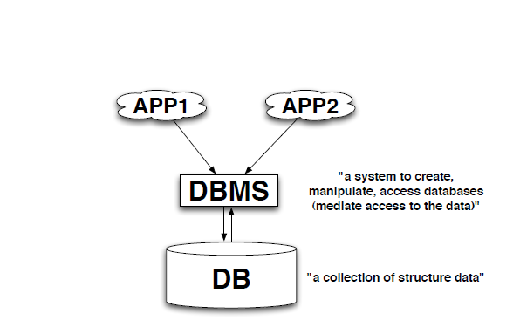

Slide 5
Database Management System (DBMS)
A Database Management System (DBMS) consists of software that organizes the storage of data.
Controls the creation, maintenance, and use of the database storage structures of organizations and of their end users.
In large systems, a DBMS allows users and other software to store and retrieve data in a structured way.

Slide 6
Database Management System (DBMS)
– add, remove, update records
– retrieve data that match certain criteria
– cross-reference data in different tables
– perform complex aggregate calculation

Slide 7
Database Management System (DBMS)
DBMS are usually categorized according to the database model that they support, such as the network, relational or object model.
The model tends to determine the query languages that are available to access the database.
One commonly used query language for the relational database is SQL.
Although SQL syntax and function can vary from one DBMS to another.

Slide 8
DBMS Managing Factors
Performance.
Concurrency.
Integrity.
Recovery from hardware failures.

Slide 9
Advantages of DBMS
Controlling Redundancy
Restricting Unauthorized Access
Providing Persistent Storage for Program Objects
Providing Storage Structures and Search Techniques for Efficient Query Processing
Providing Backup and Recovery
Providing Multiple User Interfaces
Representing Complex Relationships among Data
Enforcing Integrity Constraints

Slide 10
Flat file vs. Relational DB
Flat file databases store all information in a single data table. For large databases this may mean much duplicate information.
Relational databases have a table for each type of data and the tables ‘point' to each other. Thus they are more efficient, though they maybe more difficult to manage.

Slide 11
Relational Database
A relational database matches data using common characteristics found within the data set.
The resulting groups of data are organized and are much easier for people to understand.
The software used to do this grouping is called a relational database management system.

Slide 12
RDBMS Components
Interface drivers - A user or application program initiates either schema modification or content modification. These drivers are built on top of SQL. They provide methods to prepare statements, execute statements, fetch results, etc. An important example is the ODBC driver.
SQL engine - This component interprets and executes the SQL query. It comprises three major components (compiler, optimizer, and execution engine).

Slide 13
RDBMS Components
Transaction engine - Transactions are sequences of operations that read or write database elements, which are grouped together.
Relational engine - Relational objects such as Table, Index, and Referential integrity constraints are implemented in this component.
Storage engine - This component stores and retrieves data records. It also provides a mechanism to store metadata and control information such as undo logs, redo logs, lock tables, etc.

Slide 14
Relational Database
System of related tables
Minimum redundancy
Referential integrity
Database keys
The ACID model (guarantee of successful transactions):
–Atomicity („all or nothing” rule)
–Consistency (only valid data in)
–Isolation (order of executed transactions)
–Durability (committed transaction will not be lost)

Slide 15
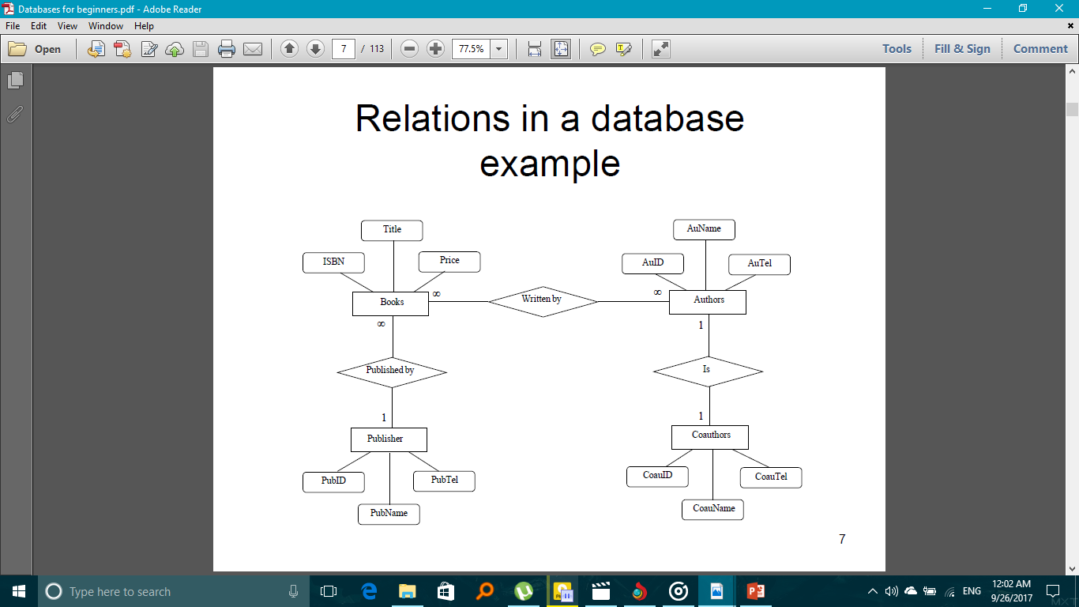
Example

Slide 16
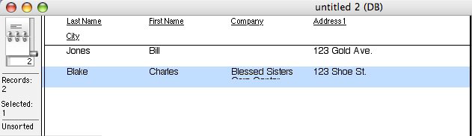
Tables
The basic units in a database are tables and the relationship between them.
Strictly, a relational database is a collection of relations (frequently called tables).

Slide 17
Database keys
Primary key
–Value unique for each record in a table
–This value can not be used twice
–AutoNumber guarantees uniqueness but does not carry any useful information
Foreign keys
–Used to create relationships between tables
–No uniqueness constraint for foreign keys
Relation between primary and foreign keys
–Same format
–Same values

Slide 18
Data warehouse
A data warehouse stores data from current and previous years — data extracted from the various operational databases of an organization.
It becomes the central source of data that has been screened, edited, standardized and integrated so that it can be used by managers and other end-user professionals throughout an organization.

Slide 19
Real-time databases
A real-time database is a processing system designed to handle workloads whose state may change constantly.
This differs from traditional databases containing persistent data, mostly unaffected by time.
Real-time processing means that a transaction is processed fast enough for the result to come back and be acted on right away.
Real-time databases are useful for accounting, banking, law, medical records, multi-media, process control, reservation systems, and scientific data analysis.
As computers increase in power and can store more data, real-time databases become integrated into society and are employed in many applications

Slide 20
NoSQL Databases
The next generation of database systems is known as NoSQL databases and document oriented databases.
NoSQL databases are often very fast, do not require fixed table schemas.

Slide 21
MDAC
The Microsoft Data Access Components (MDAC) is the framework that makes it possible to connect and communicate with the database.
MDAC includes the following components:
• ODBC (Open Database Connectivity)
• OLE DB
• ADO (ActiveX Data Objects)
MDAC also installs several data providers you can use to open a connection to a specific data source, such as an MS Access database.

Slide 22
ODBC
Open Database Connectivity (ODBC) is a native interface that is accessed through a programming language that can make calls into a native library. In MDAC this interface is defined as a DLL.
A separate module or driver is needed for each database that must be accessed.

Slide 23
OLE DB
OLE allows MDAC applications access to different types of data stores in a uniform manner.
Microsoft has used this technology to separate the application from the data store that it needs to access.
This was done because different applications need access to different types and sources of data, and do not necessarily need to know how to access technology-specific functionality. The technology is conceptually divided into consumers and providers.
The consumers are the applications that need access to the data, and the provider is the software component that exposes an OLE DB interface through the use of the Component Object Model (or COM).

Slide 24
ADO (ActiveX Data Objects)
ActiveX Data Objects (ADO) is a high level programming interface to OLE DB.
It uses a hierarchical object model to allow applications to programmatically create, retrieve, update and delete data from sources supported by OLE DB.
ADO consists of a series of hierarchical COM-based objects and collections, an object that acts as a container of many other objects.
A programmer can directly access ADO objects to manipulate data, or can send an SQL query to the database via several ADO mechanisms.

Slide 25
Structured Query Language (SQL)
SQL is a database computer language designed for managing data in relational database management systems (RDBMS).
SQL is a procedure language which tells what to do, and not how to do.

Slide 26
SQL components:
Data Definition Language – DDL
Data Manipulation Language – DML
Data Control Language - DCL

Slide 27
Data Definition Language (DDL)
The Data Definition Language (DDL) manages table and index structure.
The most basic items of DDL are the CREATE, ALTER, RENAME and DROP statements:
• CREATE creates an object (a table, for example) in the database.
• DROP deletes an object in the database, usually irretrievably.
• ALTER modifies the structure an existing object in various ways—for example, adding a column to an existing table.

Slide 28
Data Manipulation Language (DML)
The Data Manipulation Language (DML) is the subset of SQL used to add, update and delete data.
The acronym CRUD refers to all of the major functions that need to be implemented in a relational database application to consider it complete.
Operation SQL
Create INSERT
Read (Retrieve) SELECT
Update UPDATE
Delete (Destroy) DELETE

Slide 29
Microsoft SQL Server
Microsoft SQL Server is a relational model database server produced by Microsoft. Its primary query languages are T-SQL and ANSI SQL.
The latest version is 14.0 Microsoft SQL Server 2017.
The Microsoft SQL Server comes in different versions, such as:
• SQL Server Developer Edition
• SQL Server Enterprise Edition
• SQL Server Web Edition
• SQL Server Express Edition
• Etc.

Slide 30
Microsoft Office Access
Microsoft Office Access, previously known as Microsoft Access, is a relational database management system from Microsoft that combines the relational Microsoft Jet Database Engine with a graphical user interface and software development tools.
Microsoft Access is a file server-based database. Unlike client-server relational database management systems (RDBMS), e.g., Microsoft SQL Server, Microsoft Access does not implement database triggers, stored procedures, or transaction logging.

Slide 31
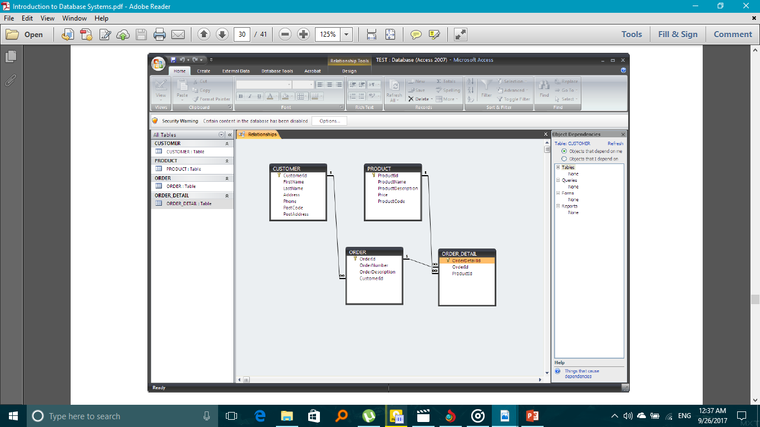

Slide 32


